Slide 1
Sect. 4.4 Applications of Trigonometry
© Copyright all rights reserved to Homework depot: www.BCMath.ca

Slide 2
Deriving an Trig. Function:
When trying to derive a trig function, the difference between the location of two maximum points OR two minimum points is equal to the period
The horizontal difference between a Max and Min is half the period
The horizonal difference between two maximum points or two minimum points is the period
The vertical difference between a maximum point and a minimum point is twice the amplitude
The average of the vertical distance between a maximum point and a minimum point is the vertical displacement/shift

Slide 3
I) Applications of Trigonometric Functions in the REAL world:
Mechanical Engineering
  Circular or Periodic Motions
  Bicycles, Ferris Wheels,
  Simple Harmonic Motions (Springs)
Ecological Studies
  Ocean Tides (High and Low tides)
  Ocean Depths
Astronomy
  Solar System, Hayley’s Comet
Physics
  Waves: Sound waves, Electromagnetic waves
  Light
© Copyright all rights reserved to Homework depot: www.BCMath.ca

Slide 4
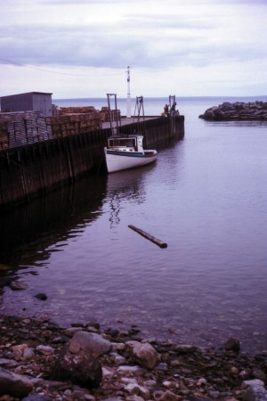
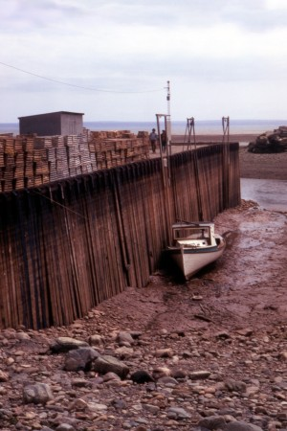
II) Ocean Tides
Earth's ocean surface will rise and fall periodically
High tide occurs when water level peaks
Low tide occurs when ocean levels is at it’s minimum
When water levels begin to change (Slack point/ Turning)
Caused by the gravitational pulls from the Moon and the Sun acting on the oceans (wikipedia)
As the moon rotates around the earth, different parts of the moon will generate different amounts of gravitatonal pull on the ocean surface
Important for coastal navigation
http://en.wikipedia.org/wiki/Tidal_force
High tide at
Bay of Fundy
Low tide at
Bay of Fundy
© Copyright all rights reserved to Homework depot: www.BCMath.ca

Slide 5

Ex: If high tide (10.6m) occur at 3:30am and low tide (3.9m) is 8.5 hours later, write an equation for the depth of the water at any time, t hours.
High tide occurs at 3:30am
with ocean depths at 10.9m
Ocean levels will fluctuate
up and down over several hours
Low tide occurs 8.5 hours later
with ocean levels at 3.9m
© Copyright all rights reserved to Homework depot: www.BCMath.ca

Slide 6
Ex: If high tide (10.6m) occur at 3:30am and low tide (3.9m) is 8.5 hours later,
a) Write a Sine Function and Cosine Function for the depth of the water at any time, t hours, within a day.
b) Graph the function
c) How high is the tide at 8am?
d) In order to set sail for a large boat, the tide must be at least 9meters high. In a 24 hour cycle, during what times can you set sail?

Slide 7
Ex: If high tide (10.6m) occur at 3:30am and low tide (3.9m) is 8.5 hours later, write an equation for the depth of the water at any time, t hours.
y
High Tide
High Tide
11
10
9
8
7
6
5
4
3
Low Tide
2
1
x
0
2
4
6
8
10
12
14
16
18
20
22
© Copyright all rights reserved to Homework depot: www.BCMath.ca

Slide 8
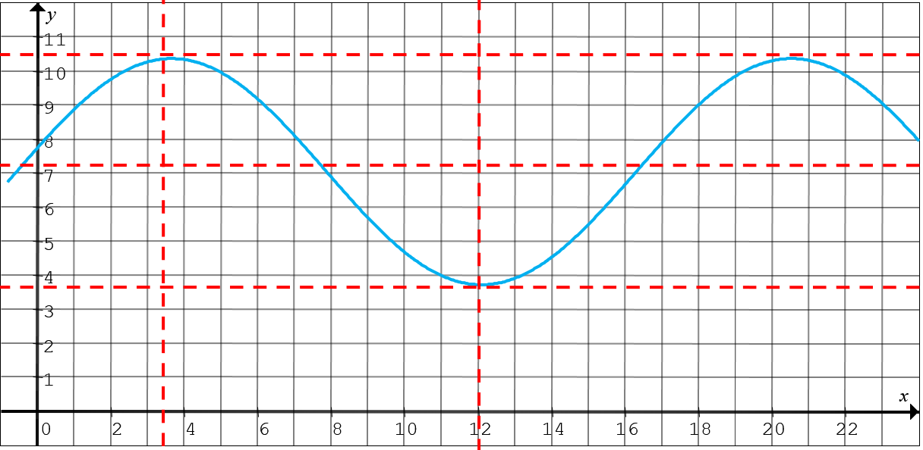
To convert this graph into a sine function, just change where the graph begins. Instead at the highest point, start ¼ of the period to the left!
Period = 17
¼ Period = 17/4 = 4.5
Between the times of 12:45am to 6:14am and 5:45pm to 11:14pm, the height of the tide is 9m or higher. These are times that you can set sail.

Slide 9
III) Ferris Wheel Problem:
A Ferris Wheel at a park has riders get on at the bottom of the wheel, which is 11m above the ground. The highest point of the ride is 55m above ground. The ride takes 120s to complete one revolution. Derive a formula in the form of :
for the height of a rider.
y
40
20
0
20
40
60
80
100
x
120
© Copyright all rights reserved to Homework depot: www.BCMath.ca

Slide 10
A Ferris Wheel at a park has riders get on at the bottom of the wheel, which is 11m above the ground. The highest point of the ride is 55m above ground. The ride takes 120s to complete one revolution.
a) Derive a Cosine Function that determines the height of the passenger as a function of time (t) from when they get on
b) Derive a Sine Function for the height of the passengers as a function of time
c) Graph the height of the passenger on the ferris wheel as a function of time
d)What is the height of the passenger after 30s on the ferris wheel?
e) After how many seconds from getting on will the passenger be at the maximum height?
f) Suppose the ride makes two full revolutions, for how many seconds will passengers be above 40meters tall when they are on the Ferris wheel?

Slide 11
The height of the rider v.s. time creates a sinusoidal wave
To find the formula for the equation, use the graph to obtain the amplitude, period, vertical & horizontal shifts
y
40
20
0
20
40
60
80
100
x
120
No horizontal shift, the graph begins at t = 0.
However, there’s a vertical reflection. (Upside Down Cosine Function) Graph begins at the bottom
If you want to write it as a sine function, start
the graph ¼ period to the right (30s)
© Copyright all rights reserved to Homework depot: www.BCMath.ca

Slide 12
Q1: Find the height of the rider 30seconds after the ride begins:
The height of the rider after 30s will be 33meters above the ground
Q2: Within 1 complete revolution, what is the total amount of time a rider on the ferris wheel will spend above 40m?
y
Find the intersection points
between the two functions
The time above 40m will be
the horizontal difference between the two points
40
20
Multiply this by 2 for 2 cycles:
0
20
40
60
80
100
x
120
© Copyright all rights reserved to Homework depot: www.BCMath.ca

Slide 13
IV) Earth and Sun in the Solar System
The earth circulates in an elliptical orbit around the sun
Perogee (Perihelion) point in orbit where the earth-sun distance is at its minimum (early January - Winter)
  Distance = 147.5 million km (2008)
Apogee (Aphelion) point in orbit where the earth-sun distance is at its maximum (early July - Summer)
  Distance = 152.6 million km (2008)
Earth’s orbit is stabilizing, but changes slightly every year
http://en.wikipedia.org/wiki/Apsis
Note: Seasons depend on earth’s axis of orbit, not on earth-sun distance
© Copyright all rights reserved to Homework depot: www.BCMath.ca

Slide 14


Aphelion: Distance between
the earth and sun is longest
at this point.
D=152.6 million km
Perihelion: distance
between the earth and
sun is shortest at this point
D = 147.5million km
http://www.spaceweather.com/glossary/aphelion.html
© Copyright all rights reserved to Homework depot: www.BCMath.ca

Slide 15
Ex: In 2020, perihelion is on January 5 and aphelion is on July 4 (180 days in between).
Perihelion (147,000,000km) Aphelion (149,600,000km)
a) Express the distance, d million km, from Earth to sun as a sinusoidal function of the number of days of the year.
b) Express the distance, “d” million km, from Earth to sun as a “Cosine Function”
c) Graph the distance of the earth from the sun as a function of the time (days) in the year
d) Use the function to find the earth/sun distance on Dec 13, 2020

Slide 16
Ex: In 2020, perihelion is on January 5 and aphelion is on July 4. Express the distance, d million km, from Earth to sun as a sinusoidal function of the number of days of the year.
b) Use the function to find the earth/sun distance on Dec 13, 2020
y
154
153
Aphelion
152
151
150
149
148
147
Perihelion
146
0
30
60
90
120
150
180
210
240
270
300
330
360
© Copyright all rights reserved to Homework depot: www.BCMath.ca

Slide 17
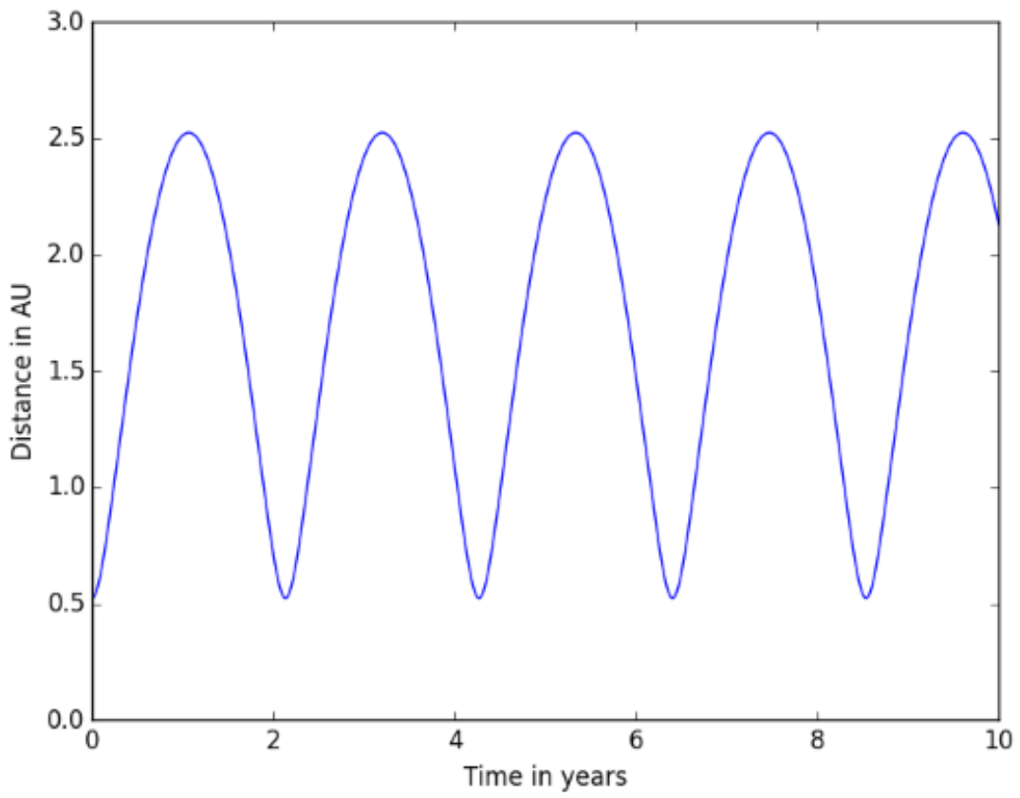
The following graph shows the distance between earth and mars, with distance measured in astronomical units (1AU=150 million km). One period is about 26months. On October 26, 2020, the Earth/Mars distance was a minimum.
a) Write a Cosine function for the earth mars distance
b) How far is the earth/mars today?

